Slide 1

Capstone Project
AliFit.com.au
By Scott Parker
Notes:
AliFit.com.au will be registered once a few issues are resolved.

Slide 2
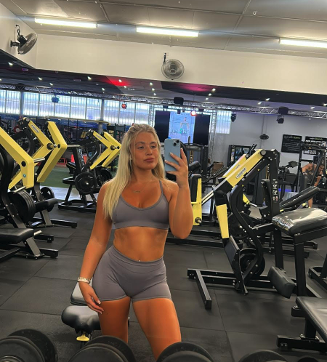
The what….
AliFit.com.au
A personal training website thats moving from being instagram based to web based.
Aims to increase the number of clients that Alison can attract.
Provide a platform to create automation and reduce manual handling throughout the signup process.

Slide 3

The why…
Client: Alison Stewart
Attracting new clients from outside her normal scope.
Showcase Alison's Success as a PT.
Give Information About Training Plans.
Give a high level view of her meal plans and recipes.
Showcase Alison's personal commitment to each new client
Notes:
The business case for this project resolves around attracting users from further afield. She has the core features of a business setup through her instagram page.
She wants to further this to give it a more professional feel.

Slide 4

Client Specifications
Colour scheme matching her current logo
Displaying progress pictures of previous clients (biggest selling point)
About me section showing who Alison is and what she does.
Info about the plans and how they work
No details around cost, that will be discussed after they sign up.
Notes:
Alisons specifications were simple. Following her business model using success stories to promote her business and attract clients.
Cost and specifics about each plans were kept away from view as Alison wants to speak to potential clients to create that relationship.

Slide 5
Indecisiveness & Limitations
Sports Info/Statistics App
A friend reached out to me who runs a successful twitter page with a request to make him application to help analyse football data.
03
Gym/Fitness App
Initial Idea: Showcase skills whilst creating something you are knowledgeable about
01
02
Clothing Website
A shop front for a mens clothing business.
Notes:
The initial idea and what i wanted to create was along the same lines as to what Alison’s business does already.
I finally decided to make the website for Alison given that i have enough knowledge about the business to get an application created without too much initial input.
Something that would become challenging as the project progressed.

Slide 6

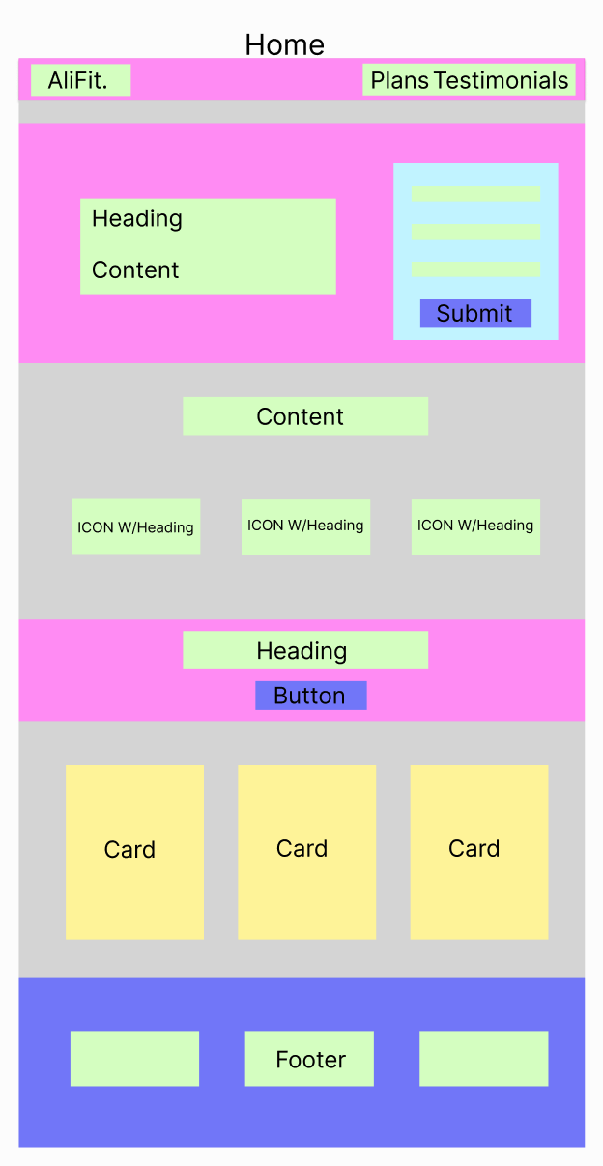
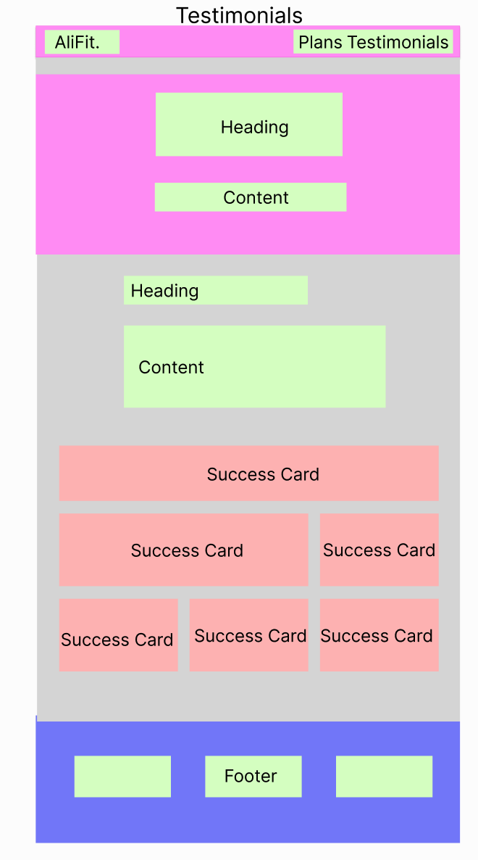
Initial Design
Inspiration
Notepad and pen
Layout
Figma Low-Fi Design
Colours and Themes
Contrasting Colours
Fluid
Notes:
Simple clean and fluid to suit mobile.

Slide 7
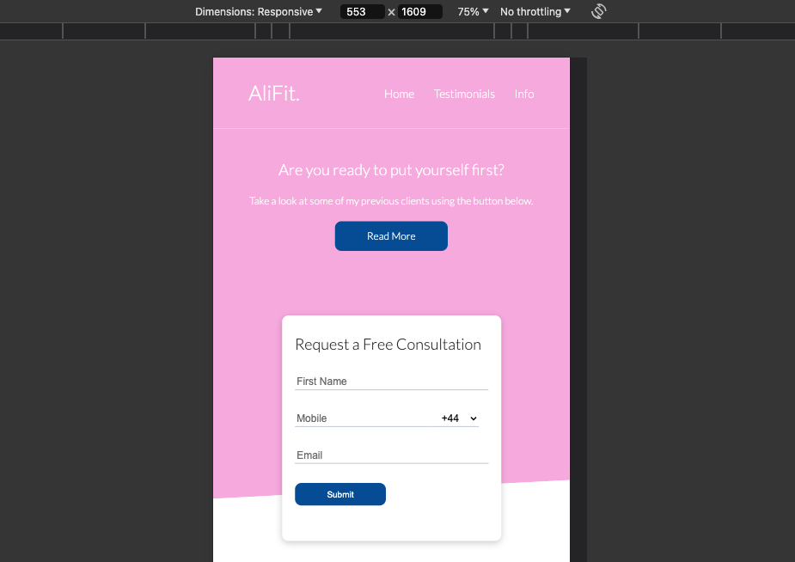
Fluidity & Responsiveness
We estimate 90% of alifits clients will come from mobile.
Current clients are attracted through instagram.
Website needs to showcase progress photos clearly.
Notes:
This was the main design aspect of the website. Attracting new clients from the web is something that the client has not been able to previously.

Slide 8
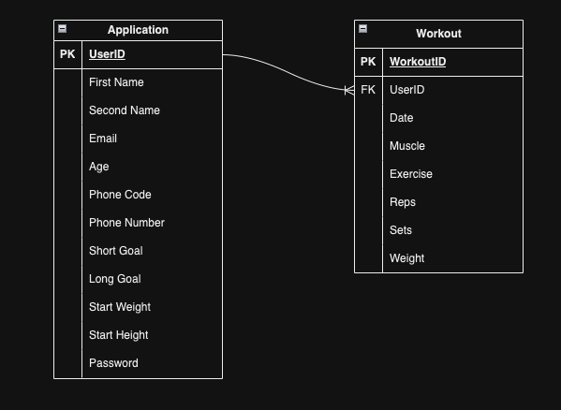
Drawio
Future Integration:
Workout data stored
Charts Query the backend to present data
User credentials stored and used on a login page.
Notes:
Currently all data is stored in the client section of Mongo DB. Further developments would integrate a workout tracker which adds the password field and is linked to the user through the UserID.
Authentication would be done through the email and password and data would be displayed to the user based upon their credentials.

Slide 9
Backend Integration
Mongo DB Atlas
Client/users
AWS EC2
Notes:
Simple Design, further developments would make this more complex.
Client submits request to AWS
AWS Responds with front end container to present the website
Client sends requests to AWS to access information in the backend
MongoDB responds with information and sends it back to AWS to present to the client.

Slide 10
Admin Requests
Request | Priority | Complete
List all users that have signed up. | High | Y
Change User Details in database | Medium | Y
Delete Users | Low | Y
Return users with set parameters | Low | N
Notes:
Future developments will take this further. The return parameters will be use to

Slide 11
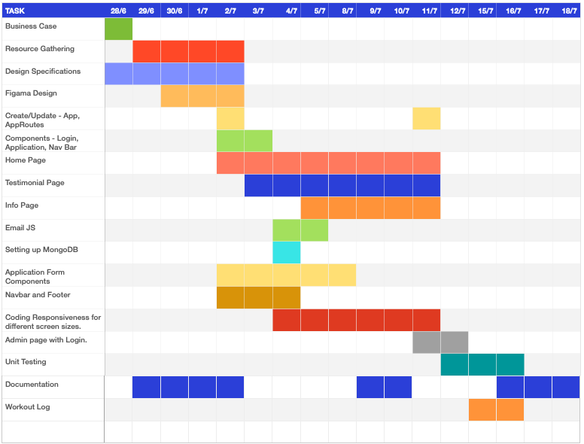
Gantt Chart
Very Useful.
Helps keep track of outstanding features.
Clearly keeps track of progress.
Does not keep track of constraints as they arise.
Notes:
First time using the chart, very useful but also could of been a lot better.
Seen lots of examples of more detailed charts, would use in the future,

Slide 12
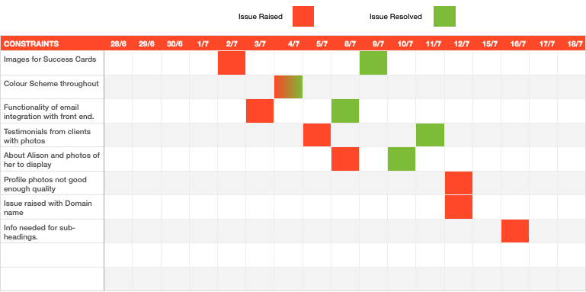
Constraints
Important to manage stakeholder expectations.
Things will not always go to plan.
Dealing with speed bumps is part of every job.
Notes:
Managing expectations throughout projects is something i've had a lot of exposure too with my old job.
Being able to visualise these constraints makes it easier for clients and stakeholders to understand.

Slide 13
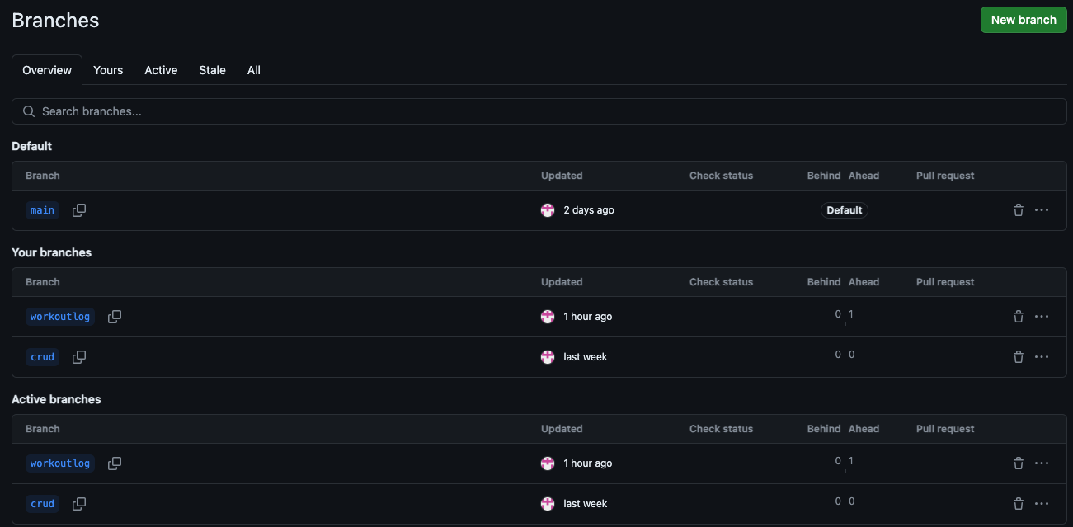
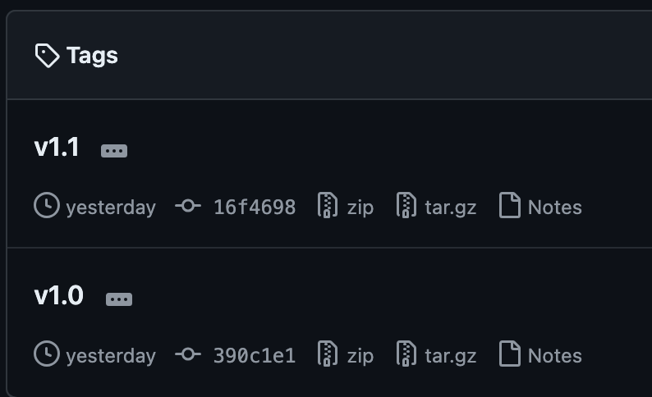
Version Control & Branches
Version 1.0 - First Deployment
Version 1.1 - Admin Page Added with Backend Integration
Version 1.2 - Workout Page - Not Published

Slide 14

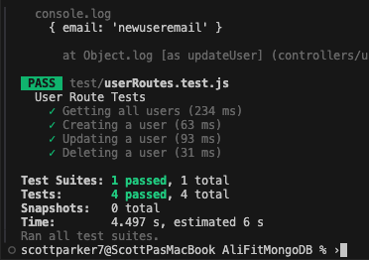

Backend Testing
Testing completed using Jest and Supertest.
Using Crud
MVC Model.
JEST
Notes:
Backend testing using jest and supertest was challenging for me, having only basic knowledge of what it does.
It was extremely helpful in creating

Slide 15
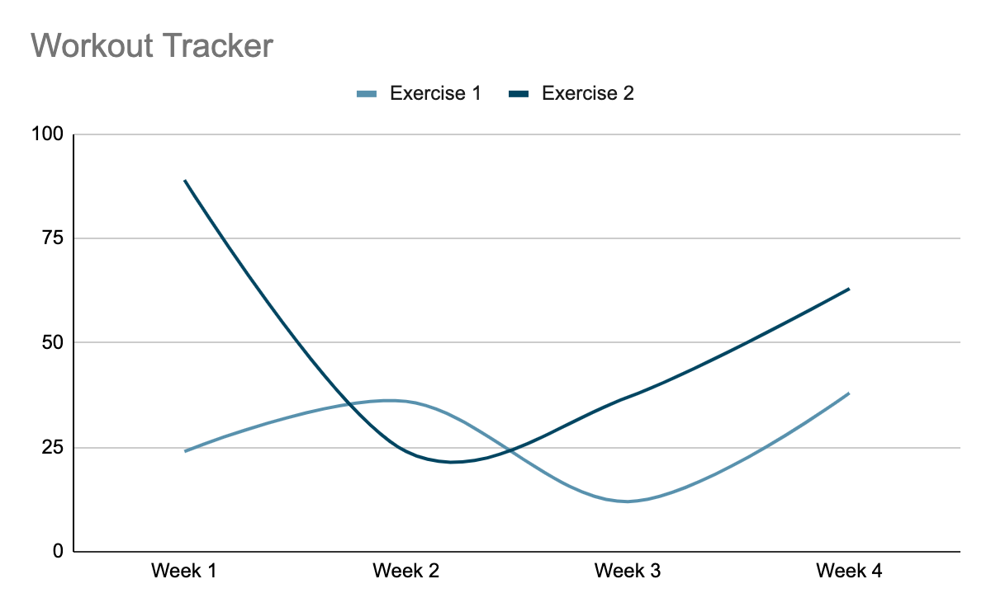
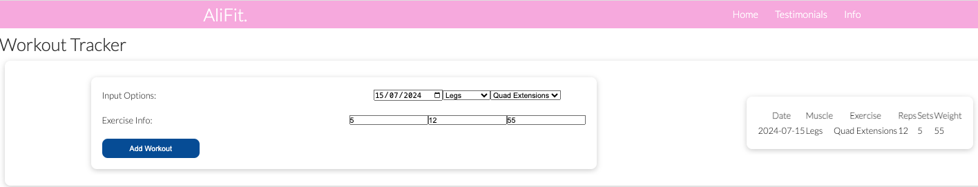
Work in progress…
Workout Tracker has input options to select the date and what was done.
This then feeds the table to the right of the box.
The chart will have options to select exercises and muscle groups that would display progress over the 12 week program.

Slide 16


Out Of Scope
Workout Tracker
User Authentication
Backend Integration
Notes:
Workout tracker is in progress and this will naturally incorporate user authentication as a result. Will show the progress of where i am at during the demonstration.

Slide 17

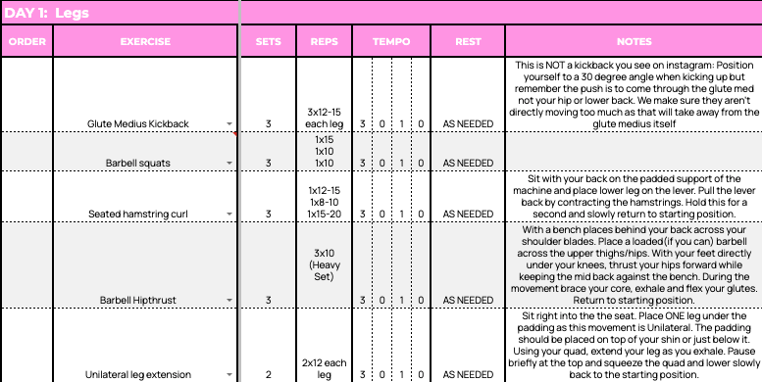
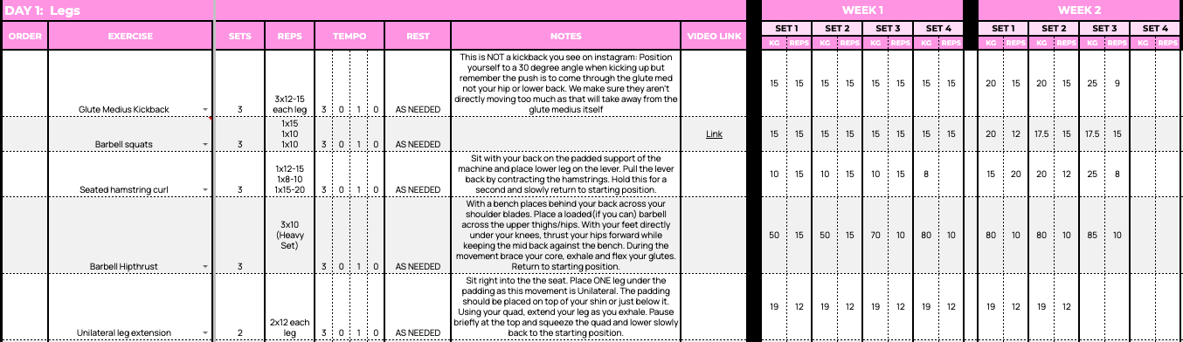
Future Developments…
Move from Excel to the Cloud
Notes:
Alison has in depth training plans which she creates each client and sends them in a google docs form. Naturally this would be built in the website where she can customise each plan for the client.
Once this is complete it would remove the need for manually storing docs on your phone and everything would be hosted in the cloud.

Slide 18

Outcome
Achieved what i set out to do - Create a fluid and attractive website.
Really enjoy building the front end and spending time making the application work.
Next steps would be to update sections with professional photos.
Stakeholder engagement is crucial to a successful project.

Slide 19

Resources
MongoDB Atlas
Docker
AWS EC2
NodeJS
React
Axios
SuperTest
Jest
AWS EC2

Slide 20
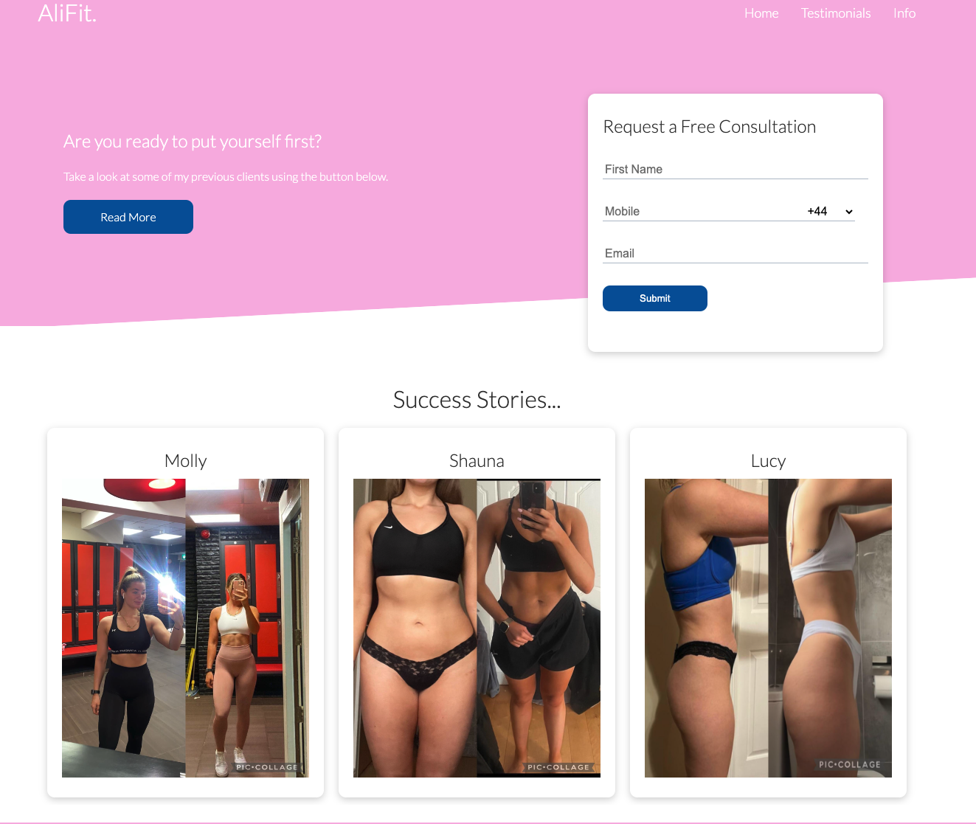
Demo
alifit.com.au

Slide 21
Questions?

